Slide 1
CSE-105:
PROGRAMMING FUNDAMENTALS
LECTURE 3: PROBLEM SOLVING
COURSE INSTRUCTOR: MD. SHAMSUJJOHA

Slide 2
Problem Solving
In this lecture we will learn about:
  Introduction to Problem Solving
  Software development method (SDM)
    Specification of needs
    Problem analysis
    Design and algorithmic representation
    Implementation
    Testing and verification
    Documentation

Slide 3
The General Form of a Simple Program
Simple C programs have the form
directives
int main(void)
{
statements
}

Slide 4
The General Form of a Simple Program
C uses { and } in much the same way that some other languages use words like begin and end, respectively.
Even the simplest C programs rely on three key language features:
  Directives
  Functions
  Statements

Slide 5
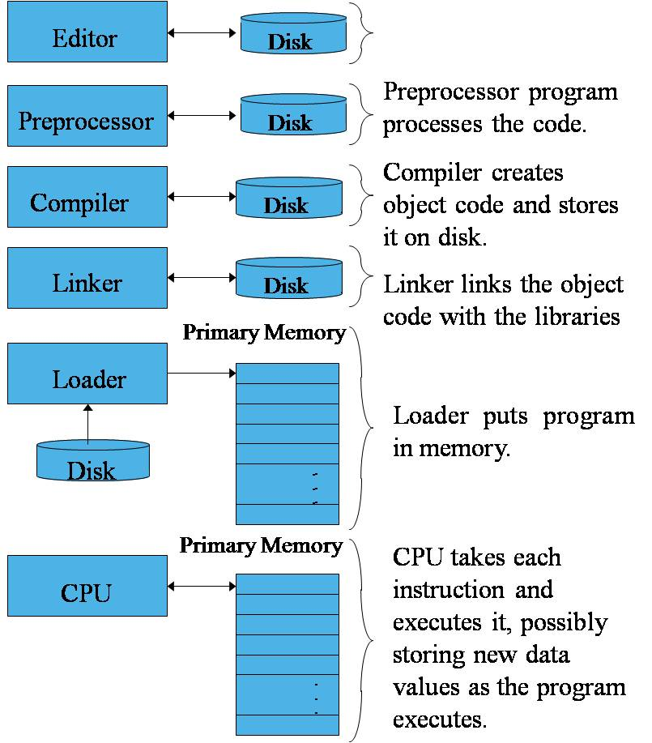
Directives
Before a C program is compiled, it is first edited by a preprocessor.
Commands intended for the preprocessor are called directives.
Example:
#include <stdio.h>
<stdio.h> is a header containing information about C’s standard I/O library.
Directives always begin with a # character.
By default, directives are one line long; there’s no semicolon or other special marker at the end.

Slide 6
Functions
A function is a series of statements that have been grouped together and given a name.
Library functions are provided as part of the C implementation.
A function that computes a value uses a return statement to specify what value it “returns”:
return x + 1;

Slide 7
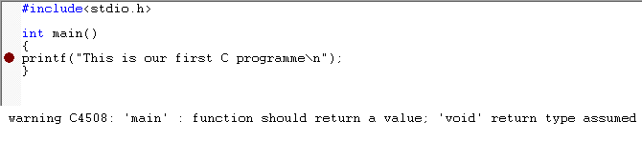
The main Function
The main function is mandatory.
main is special: it gets called automatically when the program is executed.
main returns a status code; the value 0 (Zero) indicates normal program termination.
If there’s no return statement at the end of the main function, many compilers will produce a warning message.

Slide 8
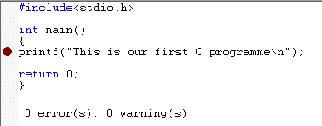
The main Function
The main function is mandatory.
main is special: it gets called automatically when the program is executed.
main returns a status code; the value 0 (Zero) indicates normal program termination.
If there’s no return statement at the end of the main function, many compilers will produce a warning message.

Slide 9
Statements
A statement is a command to be executed when the program runs.
first.c uses only two kinds of statements. One is the return statement; the other is the print statement.
Asking a function to perform its assigned task is known as calling the function.
first.c calls printf to display a string: “This is our first C programme”

Slide 10
Printing Strings
C requires that each statement end with a semicolon.
There’s one exception: the compound statement.
Directives are normally one line long, and they don’t end with a semicolon.
When the printf function displays a string literal—characters enclosed in double quotation marks—it doesn’t show the quotation marks.
To make printf advance one line, include \n (the new-line character) in the string to be printed.

Slide 11
Printing Strings
The statement
printf(“Hello World\n");
could be replaced by two calls of printf:
printf(“Hello ");
printf(“World\n");
The new-line character can appear more than once in a string literal:
printf(“Hello\nWOrld\n");

Slide 12
Variables and Assignment
Most programs need to a way to store data temporarily during program execution.
These storage locations are called variables.

Slide 13
Types
Every variable must have a type.
C has a wide variety of types, including int and float.
A variable of type int (short for integer) can store a whole number such as 0, 1, 392, or –2553.

Slide 14
Types
A variable of type float (short for floating-point) can store much larger numbers than an int variable.
Also, a float variable can store numbers with digits after the decimal point, like 379.125.
Drawbacks of float variables:
  Slower arithmetic
  Approximate nature of float values

Slide 15
Declarations
Variables must be declared before they are used.
Variables can be declared one at a time:
int height;
float profit;
Alternatively, several can be declared at the same time:
int height, length, width, volume;
float profit, loss;

Slide 16
Declarations
When main contains declarations, these must precede statements:
int main(void)
{
declarations
statements
}

Slide 17
Assignment
A variable can be given a value by means of assignment:
height = 8;
The number 8 is said to be a constant.
Before a variable is assigned a value—or is used in any other way—it must first be declared.

Slide 18
Assignment
A constant assigned to a float variable usually contains a decimal point:
profit = 2150.48;
It’s best to append the letter f to a floating-point constant if it is assigned to a float variable:
profit = 2150.48f;
An int variable is normally assigned a value of type int, and a float variable is normally assigned a value of type float.
Mixing types (such as assigning an int value to a float variable or assigning a float value to an int variable) is possible but not always safe.

Slide 19
Assignment
Once a variable has been assigned a value, it can be used to help compute the value of another variable:
height = 8;
length = 12;
width = 10;
volume = height * length * width;
/* volume is now 960 */
The right side of an assignment can be a formula (or expression, in C terminology) involving constants, variables, and operators.

Slide 20
Printing the Value of a Variable
printf can be used to display the current value of a variable.
To write the message
Height: h
where h is the current value of the height variable, we’d use the following call of printf:
printf("Height: %d\n", height);
%d is a placeholder indicating where the value of height is to be filled in.

Slide 21
Printing the Value of a Variable
%d works only for int variables; to print a float variable, use %f instead.
By default, %f displays a number with six digits after the decimal point.
To force %f to display p digits after the decimal point, put .p between % and f.
To print the line Profit: $2150.48
use the following call of printf:
printf("Profit: $%.2f\n", profit);
There’s no limit to the number of variables that can be printed by a single call of printf:
printf("Height: %d Length: %d\n", height, length);

Slide 22
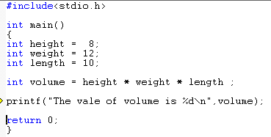
The Code

Slide 23
Problem Solving Methodology
1. State the problem clearly
2. Describe the input/output information
3. Work the problem by hand, give example
4. Develop a solution (Algorithm Development)
  and Convert it to a program (C program)
5. Test the solution with a variety of data

Slide 24
Example 1
(x1,y1)
1. Problem statement
Compute the straight line
distance between two points in a plane
2. Input/output description
(x2, y2)
Point 1 (x1, y1)
Distance between two points (distance)
Point 2 (x2, y2)

Slide 25
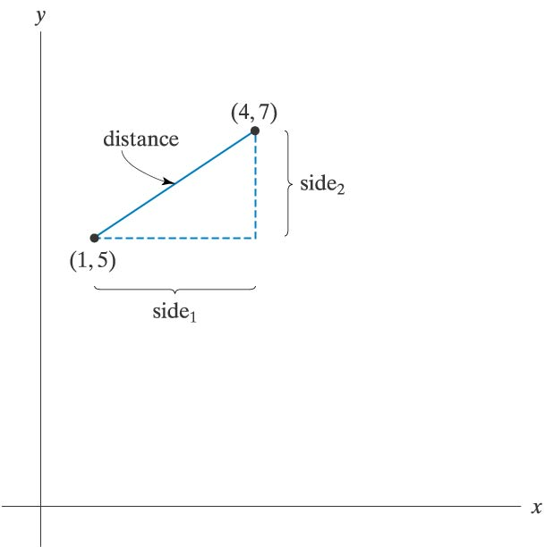

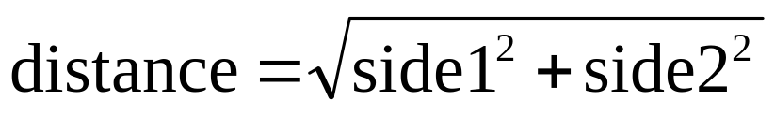
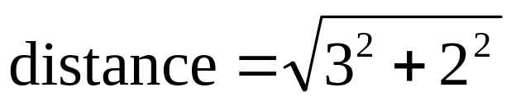
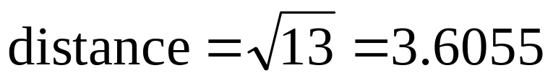
Example 1 (Cont …)
3. Hand example
side1 = 4 - 1 = 3
side2 = 7 - 5 = 2

Slide 26
Example 1 (Cont …)
4. Algorithm development and coding
a. Generalize the hand solution and list/outline the necessary operations step-by-step
  Give specific values for point1 (x1, y1) and point2 (x2, y2)
  Compute side1=x2-x1 and side2=y2-y1
  Compute
  Print distance
b. Convert the above outlined solution to a program using any language you want (see next slide for C imp.)

Slide 27
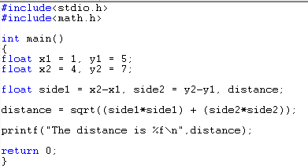
Example 1 (Cont …)

Slide 28
Example 1 (Cont …)
5. Testing
After compiling your program, run it and see if it gives the correct result.
Your program should print out
The distance is 3.6055
If not, what will you do?

Slide 29
Example 1 (Cont …)
How will you find the distance between two other points (2,5) and (10,8)?
x1=2, y1=5, x2=10, y2=8,

Slide 30
More Problem Solving
Problem solving is the process of transforming the description of a problem into a solution by using our knowledge of the problem domain and by relying on our ability to select and use appropriate problem-solving strategies, techniques and tools.
Computers can be used to help us solving problems

Slide 31
Software Development Method (SDM)
Specification of needs
Problem analysis
Design and algorithmic representation
Implementation
Testing and verification
Documentation

Slide 32
Specification of Needs
To understand exactly:
  what the problem is
  what is needed to be solve
  what the solution should provide
  if there are constraints and special conditions.

Slide 33
Problem Analysis
In the analysis phase, we should identify the following:
  Inputs to the problem, their form and the input media to be used
  Outputs expected from the problem, their form and the output media to be used
  Special constraints or conditions (if any)
  Formulas or equations to be used

Slide 34
Design and Algorithmic Representation
An algorithm is a sequence of a finite number of steps arranged in a specific logical order which, when executed, produces the solution for a problem.
An algorithm must satisfy these requirements:
  It may have input(s)
  It must have an output
  It should not be ambiguous (there should not be different interpretations to it)
    Every step in algorithm must be clear as what it is supposed to do

Slide 35
Design and Algorithmic Representation cont..
  It must be general (it can be used for different inputs)
  It must be correct and it must solve the problem for which it is designed
  It must execute and terminate in a finite amount of time
  It must be efficient enough so that it can solve the intended problem using the resource currently available on the computer
An algorithm can be represented using pseudocodes or flowcharts.

Slide 36
Control Structure
In order to tackle a problem, we need
  a correct algorithm
  to apply the algorithm at the 'good' moment
  to decide which algorithm to apply (sometimes there are more than one, depending on conditions)
  to know if a certain operation must be repeated
  →In short: we need a suitable Control Structure
In 1966, two researchers, C. Bohn and G. Jacopini, demonstrated that any algorithm can be described using only 3 control structures: sequence, selection and repetition.

Slide 37
Pseudocodes
A pseudocode is a semiformal, English-like language with limited vocabulary that can be used to design and describe algorithms.
Criteria of a good pseudocode:
  Easy to understand, precise and clear
  Gives the correct solution in all cases
  Eventually ends

Slide 38
Pseudocodes: The Sequence control structure
A series of steps or statements that are executed in the order they are written in an algorithm.
The beginning and end of a block of statements can be optionally marked with the keywords begin and end.
Example 1:
Begin
Read the birth date from the user.
Calculate the difference between the birth date and today’s date.
Print the user age.
End

Slide 39
Pseudocodes: The Selection control structure
Defines two courses of action depending on the outcome of a condition. A condition is an expression that is, when computed, evaluated to either true or false.
The keyword used are if and else.
Format:
if condition
then-part
else
else-part
end_if
Example 2:
if age is greater than 55
print “Retire”
else
print “Work Work Work”
end_if

Slide 40
Pseudocodes: The Selection control structure
Sometimes in certain situation, we may omit the else-part.
  if number is odd number
  print “This is an odd number”
  end_if
Example 3

Slide 41
Pseudocodes: The Selection control structure
Nested selection structure: basic selection structure that contains other if/else structure in its then-part or else-part.
if number is equal to 1
print “One”
else if number is equal to 2
print “Two”
else if number is equal to 3
print “Three”
else
print “Other”
end_if
Example 4

Slide 42
Pseudocodes: The Repetition control structure
Specifies a block of one or more statements that are repeatedly executed until a condition is satisfied.
The keyword used is while.
Format:
while condition
loop-body
end_while

Slide 43
Pseudocodes: The Repetition control structure
Example 5: Summing up 1 to 10
set cumulative sum to 0
set current number to 1
while current number is less or equal to 10
add the cumulative sum to current number
add 1 to current number
end_while
print the value of cumulative sum

Slide 44
Pseudocodes: The Repetition control structure
Subsequently, we can write the previous pseudocodes (example 5) with something like this.
Example 6: Summing up 10 numbers
cumulative sum = 0
current number = 1
while current number is less or equal to 10
cumulative sum = cumulative sum + current number
current number = current number + 1
end_while
print the value of cumulative sum
Note that in this algorithm, we are using both the sequence and repetition control structure

Slide 45
Pseudocodes: The Repetition control structure
Example 7:
Begin
number of users giving his birth date = 0
while number of users giving his birth date < 10
begin
Read the birth date from the user.
Calculate the difference between the birth date and today’s date.
Print the user age.
if the age is greater than 55
print “retired”
else
print “keep working”
end_if
number of user giving his birth date + 1
end
end_while
End

Slide 46
Pseudocodes: The Repetition control structure
Example 8:
while user still wants to play
begin
Select either to play on network or play against computer
    if play on network
    create connection to remote machine
    play game with connected computer
    else
    select mission
    play game locally
    end_if
    Ask user whether he/she still wants to play
  end
end_while

Slide 47
Pseudocodes: The Repetition control structure
Example 9:
while user still wants to play
begin
Select either to play on network or play against computer
if play on network
create connection to remote machine
play game with connected computer
Else
select mission
play game locally
end_if
Ask user whether he/she still wants to play
end
end_while
For readability, always use proper indentation!!!

Slide 48
Flowcharts
Flowcharts is a graph used to depict or show a step by step solution using symbols which represent a task.
The symbols used consist of geometrical shapes that are connected by flow lines.
It is an alternative to pseudocoding; whereas a pseudocode description is verbal, a flowchart is graphical in nature.

Slide 49
Flowchart Symbols
Terminal symbol - indicates the beginning and
end points of an algorithm.
Process symbol - shows an instruction other than
input, output or selection.
Input-output symbol - shows an input or an output
operation.
Disk storage I/O symbol - indicates input from or output to disk storage.
Printer output symbol - shows hardcopy printer
output.

Slide 50
Flowchart Symbols cont…
Selection symbol - shows a selection process
for two-way selection.
Off-page connector - provides continuation of a logical path on another page.
On-page connector - provides continuation
of logical path at another point in the same
page.
Flow lines - indicate the logical sequence of
execution steps in the algorithm.

Slide 51
Flowchart – sequence control structure
Statement 1
Statement 2
Statement 3
:

Slide 52
Flowchart – selection control structure
No
Yes
Condition
else-
statement(s)
then-
statement(s)

Slide 53
Flowchart – repetition control structure
yes
Loop
Statement(s)
Condition
no

Slide 54
Flowchart – example 1
Begin
Read birth date
Calculate
Age = current year – birth date
Display
age
End

Slide 55
Flowchart – example 2
Begin
Read age
YES
Age > 55?
NO
print “retired”
print “keep working”
End

Slide 56
Flowchart – example 5
Begin
sum = 0
current_number = 1
NO
current_number <= 10?
print sum
YES
sum = sum + current_number
current_number = current_number + 1
End

Slide 57
Flowchart – Home Work
Write the equivalent flowchart for each of the examples given in pseudocoding, i.e
  Example 3
  Example 4
  Example 7

Slide 58
Implementation
The process of implementing an algorithm by writing a computer program using a programming language (for example, using C language)
The output of the program must be the solution of the intended problem
The program must not do anything that it is not supposed to do
  (Think of those many viruses, buffer overflows, trojan horses, etc. that we experience almost daily. All these result from programs doing more than they were intended to do)

Slide 59
Testing and Verification
Program testing is the process of executing a program to demonstrate its correctness
Program verification is the process of ensuring that a program meets user-requirement
After the program is compiled, we must run the program and test/verify it with different inputs before the program can be released to the public or other users (or to the instructor of this class)

Slide 60
Documentation
Contains details produced at all stages of the program development cycle.
Can be done in 2 ways:
  Writing comments between your line of codes
  Creating a separate text file to explain the program
Important not only for other people to use or modify your program, but also for you to understand your own program after a long time (believe me, you will forget the details of your own program after some time ...)

Slide 61
Documentation cont…
Documentation is so important because:
  You may return to this program in future to use the whole of or a part of it again
  Other programmer or end user will need some information about your program for reference or maintenance
  You may someday have to modify the program, or may discover some errors or weaknesses in your program
Although documentation is listed as the last stage of software development method, it is actually an ongoing process which should be done from the very beginning of the software development process.

Slide 62
Volume calculation
Write a pseudocode and a flowchart for a C program that read the value of the height, width and length of a box from the user and print its volume.
Already completed ?

Slide 63
Calculating Electricity Bills
The unit for electricity usage is kWh. For domestic usage, the monthly rate is 21.8 taka/unit for the first 200 unit, 25.8 taka/unit for the next 800 units and 27.8 taka/unit for each additional units.
Given the amount of electricity units (in kWh) used by a customer, calculate the amount of money needs to be paid by the customer to PDB. A bill statement needs to be printed out.
Write a pseudocode and a flow chart to solve the above problem.

Slide 64
Sum of 1 to n
Write a pseudocode and a flowchart for a program that reads a positive integer n and then computes and prints the sum of all integers between 1 and n.

Slide 65
Summary
This chapter introduced the concept of problem solving-a process of transforming the description of a problem into a solution.
A commonly used method – SDM which consists of 6 steps
3 basic control structures : sequence, selection and repetition structures
Pseudocode vs. Flow chart

Slide 66

Questions or Suggestions

Slide 67

THANK YOU!

